Slide 1
SOFTWARE DEVELOPMENT LIFE CYCLE
(SDLC)

Slide 2
What is SDLC?
Stages in SDLC:
Planning: Identifying the project scope, objectives, feasibility, and resource requirements.
Requirements Analysis: Gathering and analyzing the specific needs and requirements of the stakeholders.
Design: Creating the architecture and design of the software based on the requirements.
Development: Writing and coding the software according to the design specifications.
Testing: Verifying that the software meets the requirements and is free of defects through various types of testing (e.g., unit testing, integration testing, system testing).
Deployment: Installing the software in the production environment so it is available for use.
Maintenance: Providing ongoing support and updates to the software after it’s deployed to fix bugs, improve performance, or add features.
SDLC stands for Software Development Life Cycle, which is a process used for planning, creating, testing, and deploying an information system. It provides a structured approach to software development, ensuring that the end product is high-quality, meets user requirements, and is delivered within time and budget constraints.

Slide 3
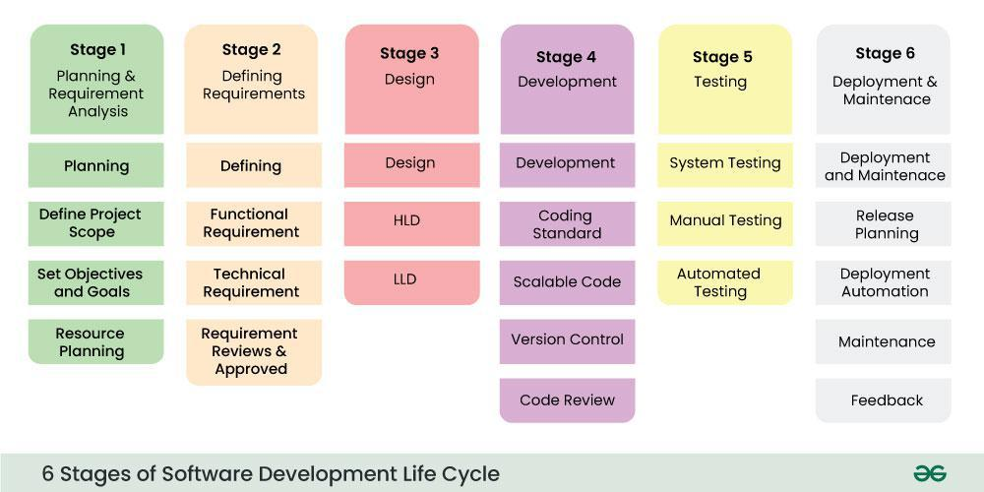

Slide 4
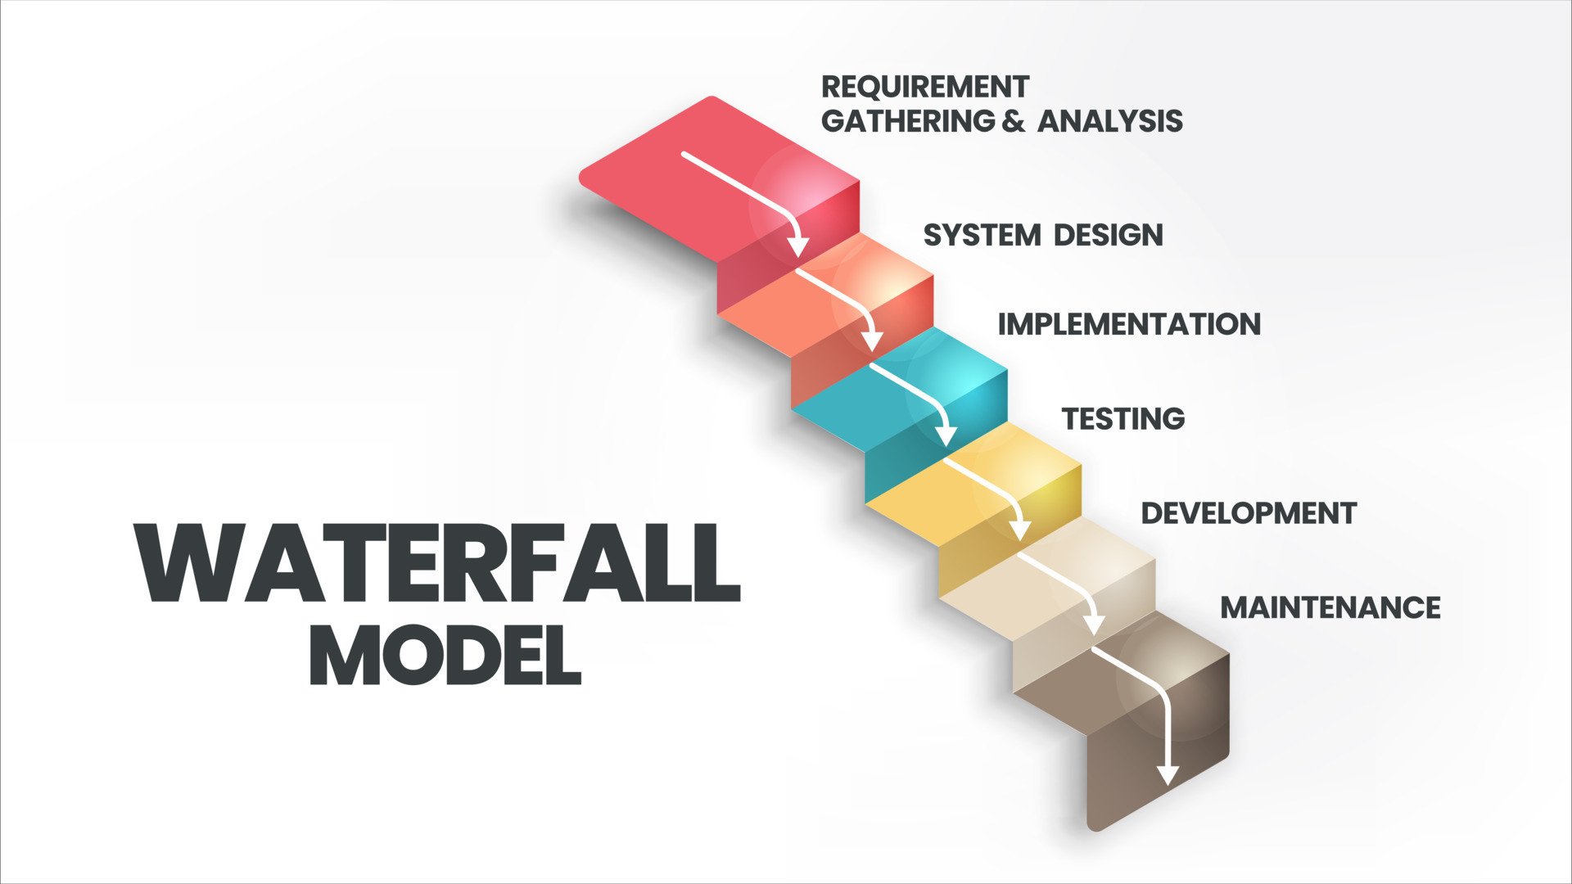
The Waterfall Model (1970s):
Strengths: It provided a clear structure and worked well for projects where requirements were well understood upfront.
Challenges: The Waterfall model lacked flexibility and adaptability. Once a phase was completed, it was difficult to go back and make changes, which made it unsuitable for projects with evolving requirements.
Phases: Requirements → Design → Implementation → Testing → Deployment → Maintenance.

Slide 5
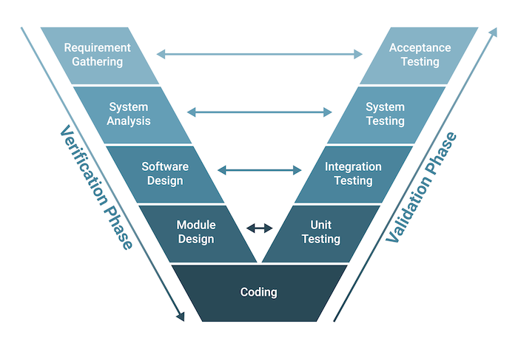
V-Model (1980s):
Strengths: The V-Model ensures that validation and verification are part of every stage, reducing defects later in development.
Challenges: Like Waterfall, it lacks flexibility, as changes during later stages are costly.
Phases: Requirements and Testing, Design and Integration Testing, Implementation and Unit Testing, etc.

Slide 6
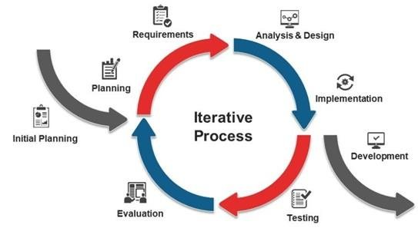
Incremental and Iterative Models (Late 1970s–1990s):
Strengths: Incremental development allows for partial deployment of a system and faster feedback, improving flexibility.
Challenges: Managing multiple iterations and ensuring integration between increments can be complex.

Slide 7
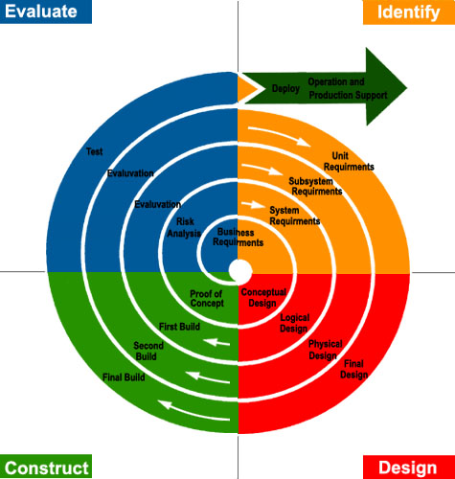
Spiral Model (1980s):
Strengths: The Spiral model is flexible and emphasizes risk management, making it suitable for large, complex projects.
Challenges: It can be expensive and requires careful management, making it less ideal for smaller projects.
Phases: It involves repeated cycles of Planning, Risk Analysis, Engineering, and Evaluation.

Slide 8
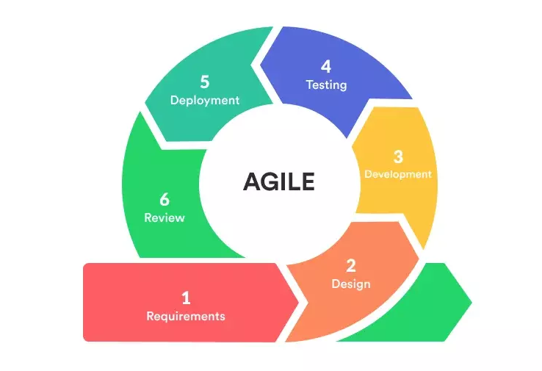
Agile Model (2001–Present):
Strengths: Agile encourages continuous delivery of functional software, adaptability to change, and close collaboration with stakeholders.
Challenges: Agile requires strong communication, and without proper discipline, it can lead to scope creep.

Slide 9
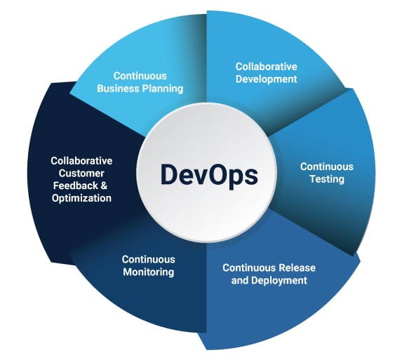
DevOps Model (2010s–Present):
Strengths: DevOps improves collaboration, speeds up delivery, and ensures the reliability of software systems through continuous monitoring.
Challenges: Implementing DevOps can be challenging for organizations with rigid structures, and it requires a significant cultural shift.

Slide 10
Thank you

